Slide 1

Buying your first computer
By: Alex lai ics3u

Slide 2

Budget
When buying your PC there is a huge range in costs. It all depends on what you need a computer for ex. if you just surf the web you don't need a $2000 computer.
For good performance and something that will last you about 5 years you could find something good for around $1000

Slide 3
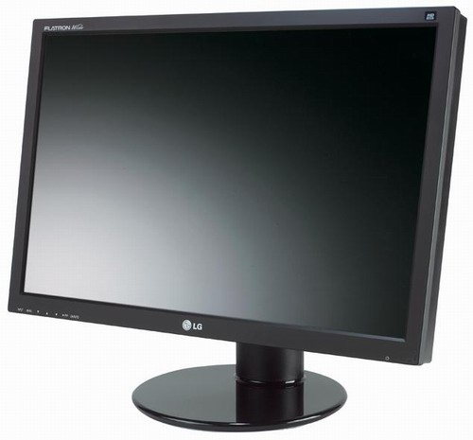
Monitor
Having a nice big monitor with a good display is great for watching movies and tv shows and makes it as close as it can get to watching tv.
there are backlit and led
Examples of good monitors:
HP 23" IPS LED Backlit Monitor - $170.00 - not too expensive for a basic beginners monitor and a good size at 23 inches
ASUS 27" Widescreen LED Monitor with 2ms Response Time - $340.00 - incredible response time,good for playing games

Slide 4
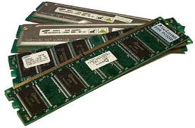
Ram
The average user doesn't need to spend a lot of money on ram because most of the time you will only have less that 3 programs running at one time. To be safe getting about 4gb of ram will cost you about $25.00 but you can always go a little bigger with 8gb for closer to $100.00
reliable ram making companies include kingston and crucial which both have a large variety.
Corsair Vengeance Pro Blue 8GB (2x4GB) DDR3 1600MHz CL9 DIMMs - $100 - very good for overclocking computers
Kingston ValueRAM 2GB DDR3 1333MHz CL9 Single Rank DIMM - $25 - very cheap if you dont want to buy lots of extra ram

Slide 5
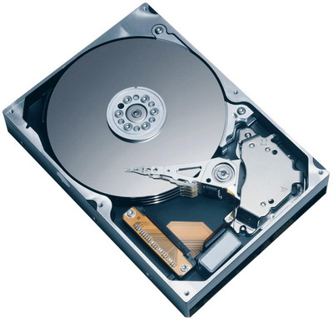
HardDrive
Your computer hard drive stores all your data on your computer and prices can range from usually $50.00- $200.00 depending on how much storage you need. For a first computer or someone who doesnt download a whole lot you would be more than happy for 500GB.
Seagate ST500DM002 Barracuda 3.5" Internal Hard Drive - 500GB, SATA-6Gb/s - $70.00 - not to expensive with more than enough space for the average user. (7200 rpm)(Cache SATA 6.0Gb/s 3.5)
WD 3TB 3.5" SATA Internal Desktop Hard Drive - $140 - lots and lots of storage, great if you keep a lot of media like music and movies on your computer. (Cache 64MB)(IntelliPower)

Slide 6
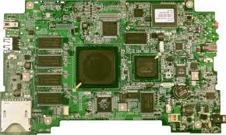
Motherboard
Buying a motherboard is a very important process because it connects many parts of the computer and has to be compatible with all these parts. You will have to research what motherboards are compatible with which parts.
Asus Z87-Pro Motherboard - ATX, LGA1150, Intel Z87 Express Chipset, 2800 MHz DDR3 (O.C.), SATA III (6Gb/s), 8-CH Audio, Gigabit LAN, Quad-GPU CrossFireX Ready - Z87-PRO - $235 - Pretty expencive but you get a lot for your money with 2800MHz and a Quad GPU
MSI Z87-G41 PC MATE Intel Z87 Motherboard - ATX, LGA 1150, Intel Z87 Chipset, 2600 MHz(OC) DDR3, SATA 6 Gb/s, Audio, Gigabit LAN, USB 3.0, 2-way CrossFire - Z87-G41 PC MATE - $115 - This board is USB 3.0 compatible and SATA
(6 Gb/s) which is very good for only $115

Slide 7
Central processing unit
A central processing unit (CPU) is the hardware in a computer that carries out the instructions of a computer program by performing the arithmetical, logical, and input/output operations of the system. Intel is a very successful company at creating CPU’s and run on computers all over the world. The faster the clock rate in a CPU the better the CPU is.
Intel Core i7-4770K Processor - Quad Core, 8MB L3 Cache, 3.5GHz, 84W, Fan, Unlocked Multiplier, 1250 MHz Graphics Core Speed - BX80646I74770K - $350 - This is a top of the line processor with incredible power and speed but is only recommended if you need all that power to run games and really big programs. (3.5GHz)
Intel BX80637I33220 Core i3-3220 Processor - Dual Core, 3MB L3 Cache, 3.30GHz, Socket H2 (LGA1155), 55W, 650-1050 MHz, Fan - $145 - This is also made my intel and is recommended for new computer users as it doesn't have an extremely fast clock rate as the i7 but the average user doesn't need all that speed and for less than half the price this is a very good buy also. (3.30GHz)

Slide 8
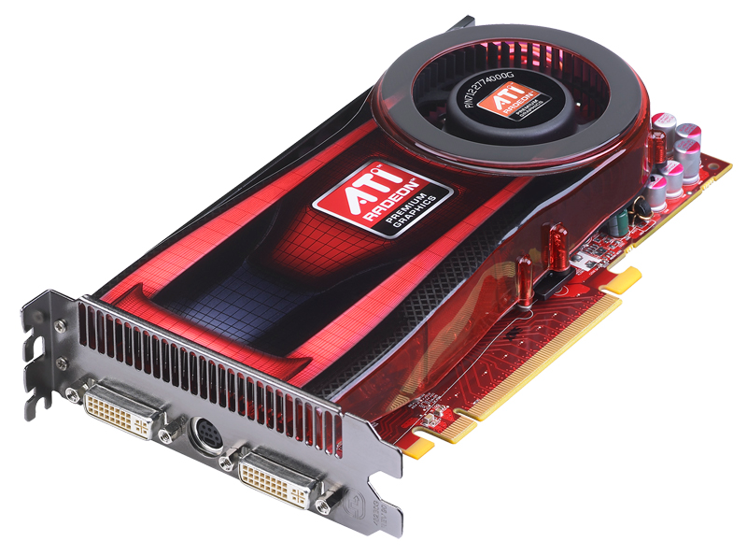
Video Card
Your computer video card is very important for your computer it handles all of your graphics.
Graphics cards range a huge amount in price from about $50-$1000 depending on your needs. GeForce and Radeon both make very good quality cards. EVGA GeForce GTX 650 Ti SSC 01G-P4-3652-KR Video Card - 1GB GDDR5, PCI-Express 3.0(x16) 2x Dual-Link DVI, Mini-HDMI, DirectX 11, Dual-Slot, Fan - $170 - If you like graphics and want great picture quality the more money you spend the better graphics you can get and for $170 this option offers great graphics for this price.
XFX Radeon R7 250 R7-250A-ZNF4 1GB DDR5, PCI-Express 3.0 (x16), AMD Eyefinity - $100 -
A $100 graphics card wont be great for people into gaming and stuff like that but for the average web surfer this video card will suit you just fine.

Slide 9
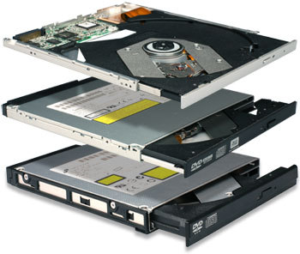
Optical Drive $30-$100
Depending if you will used CDs a lot you can either buy a better or worse optical drive. Some of the more expensive ones that cost around 100 dollars will read and write blu ray so if you feel that is important you can spend the extra money on it.
ASUS 12x Internal Blu-Ray Writer - $100 - more expensive but will read and write blu ray (very good if you use lots of CD’s).
HP 24x Internal DVD/CD Writer (DVD1265I) -$40 - lower end drive but you don't need an expensive one if you dont use it often.

Slide 10

OS
Microsoft windows 8.1 and and Apples OSX are very popular OS’s that are very user friendly. Other operating systems like chrome os and linux are free but are not used as much as OSX and 8.1 and the user interface is not nearly as nice to use and look at, To get OSX you need a apple computer but windows 8.1 will work on almost all new computers. The OS you pick depends on your preferences, all theses OS`s have great performance but very diffrent user experiences.
Windows 8.1 - $120 - The newest version of windows and if you have a touch screen computer you can get tons of functionality out of 8.1
OSX mavericks - $free on any apple computer.

Slide 11
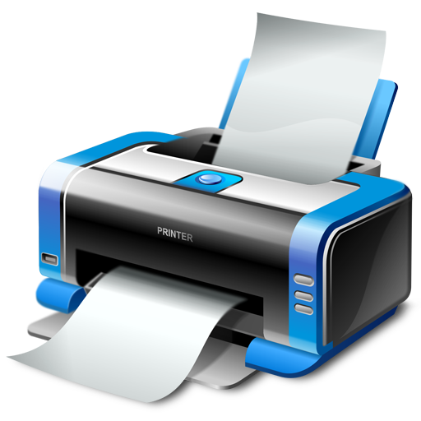
Printer
Most printers cost from 100 -200 dollars and you can get a very good one for this price.
3 main types of printers are LED, inkjets and laser printers all are quite similar with few minor differences.
Brother Monochrome Laser Printer (HL-2240D) - $80 - Prints faster than an inkjet and produces very good black and white documents that look professional.
Canon PIXMA Wireless All-In-One Inkjet Printer (MX452) - $100 - These types of printers are better for colour reproduction and have very vibrant colours.

Slide 12
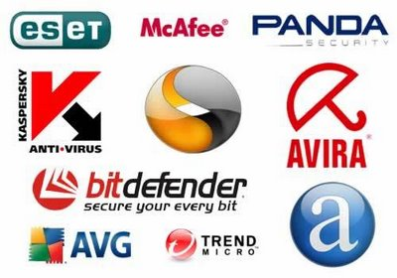
AntiVirus
There are lots of good reliable antiviruses you can buy that will protect your computer but you should make sure to have a good one to pick up on all viruses
Norton 360™ - $60 - this antivirus is well trusted and will pick up on plenty of viruses and cookies your computer will get. If you download a lot and surf on untrusted websites this antivirus is recommended
AVG antivirus - $free - this is a good starting antivirus if all you use your computer for is surfing the web and using a few regular programs.

Slide 13
Networking capability
To use the internet you need a network card and you can either get a wireless one or a card that connects to an ethernet cable.
They are not to expensive but will get expensive if you need a dual ethernet plug in likethe one listed below.
D-Link N300 Wireless PCI-E Adapter Card (DWA-548) - $30 - This is a wireless option and is great if you do not have a ethernet plug in from a wall that the computer will be in.
SIIG 2-Port Gigabit Ethernet PCI-E Card (CN-GP2011-S1) - $131 - Theres not to many people who need a dual port ethernet card and should only be recommended for people that need really high internet speeds.

Slide 14
Software to purchase
For a computer for beginners, the software you buy depends on your needs as a consumer. Lots of people don't need to purchase software because lots of programs are free and online can be very useful if you are always connected to the internet.
Photoshop Photography Program - $9.99/month - Photoshop is a very popular photo editing software and if you are new to it there are tutorials all over the web explaining it.
Audio Editor Gold 8.11 - $30 - If you want to start out with basic audio editing this option will help you starting off new to editing audio.
Microsoft office - $110 - office is one of the best options there is for creating documents and looks very professional

